Slide 1


FREE PDF BONUS — Stay to the end!
presents
Part 107 to Paid in 7 Days
Based on real survey data from pilots who've done it

Slide 2
By The End of This Webinar...
1
You'll know why 93.8% of pilots without clients are making the same critical mistake.
2
You'll discover the 3 secrets that helped pilots land their first paying client.
3
You'll see what high earners do differently than everyone else.
4
You'll get a free PDF action guide if you stay to the end.

Slide 3
You’ve Already Taken the First Step
While You Wait…
Every week you don't take action, that voice in your head gets louder:
"Maybe I'm not cut out for this."
"Maybe I should have just stuck with my day job."
"That expensive drone starts collecting dust..."
And while you're waiting? Someone else is calling the clients that should be yours.

Slide 4
The Brutal Truth
Why Most Pilots Never Get a Single Client
93.8%
of pilots who don’t have clients made
zero contact attempts
"They didn't fail. They didn't even try."

Slide 5
But Here’s the Thing…
The pilots who are winning?
They're not smarter than you.
They're not more talented.
They don't have better equipment.
They just did a few things differently.
Let me show you exactly what that is...

Slide 6
This Isn't Theory. It's Data.
563
72%
have landed at least one paying client
6%
got their first client in 7 days or less
Our goal: Get you in this group
drone pilots surveyed
85%
use consumer drones
We asked them everything: how they found clients, what worked, what didn't, their biggest mistakes, and their best advice.
Notes:
Mention the Secrets that are coming up.

Slide 7
False Belief: "I need to cold call 100 people"
SECRET #1
The Network Myth
43.9%
The Truth
You don't need strangers.
You need to tell people you know that you fly drones for money.
That's it. That's the secret.
got their first client from people they already knew
50%
got clients through INBOUND — zero outreach required
65%
needed only 0–3 contacts before getting a YES

Slide 8
False Belief: "I'm not good enough yet to charge money"
SECRET #2
The Confidence Code
What pilots think holds them back 5.5%
said "waiting for the perfect portfolio"
4×
more people struggled with confidence
than actually had portfolio problems
What actually holds them back 23.4%
imposter syndrome
The issue isn't your skills.
It's in your head.

Slide 9
What's REALLY Holding Pilots Back?
Self-reported biggest obstacles (329 responses):
Imposter Syndrome
23.4%
41%
of struggles are
MINDSET problems
Strategy Paralysis
17.9%
Other
17.9%
Regulatory Overwhelm
14.0%
Only 5.5% actually had
portfolio problems
Gatekeepers / Rejection
8.2%
“
The Portfolio Trap
5.5%
Business Admin
4.9%
"Imposter syndrome isn't a sign you're not ready. It's a sign you care about doing good work."
Pricing Confusion
4.6%
Sales Anxiety
3.7%

Slide 10
False Belief: "Getting clients takes forever"
SECRET #3
The Speed Advantage
6%
29%
65%
got clients in
7 DAYS
had clients lined up
BEFORE certification
got their first client in
3 MONTHS or less
They weren't ready. They just started.
You don't need more time. You don't need perfection. You need action.

Slide 11
The Real Estate Trap
CRITICAL INSIGHT
When we compared high earners ($10k+/yr) vs low earners ($0-$10k/yr)...
Low Earners ($0-$10k/yr)
High Earners ($10k+/yr)
Primary niche:
Primary niche:
40% Real Estate
12% Real Estate
Mapping/Surveying: 8.8%
Construction: 12%
Mapping/Surveying: 22.7%
Construction: 24%
Real estate is crowded and low-margin. High earners pivot to technical services.

Slide 12
The Real Estate Trap
What services do high earners offer vs everyone else?
Real Estate
40%
12%
Construction
12%
24%
Mapping/Surveying
8.8%
22.7%
Creative
15%
16%
Inspections
10%
10%
5%
Low Earners ($0-$10k)
Agriculture
5.2%
High Earners ($10k+)
High earners avoid real estate and focus on construction & mapping.

Slide 13

What Doesn’t Work
Pilots told us what wasted their time and money:
Email outreach
Low response rates. Cold calls and in-person outreach is better.
Lead generation platforms
Low pay, few leads, little support. Use to learn, not to earn.
A lot of free work to "build portfolio"
Too much free work backfires on credibility. Clients don't value what's free.
Waiting to feel "ready"
You'll never feel ready. Action creates confidence.
Over-investing in business setup
Logos, LLCs, equipment, and websites before clients = procrastination.
"Everyone sends emails — do something different."

Slide 14
The Pricing Paradox
What pilots learned about pricing the hard way:
The Trap "Start cheap to get experience" Underpricing hurts YOU (hard to raise rates later) and the INDUSTRY (race to the bottom)
The Solution Price fairly from day one. Add EXTRA VALUE instead. Faster delivery, bonus shots, professional communication — not discounts.
“
How successful pilots price:
"If you give it away, credibility is diminished. Don't undermine the industry."
• Research competitors (29.6%)
• Calculate costs + 40-60% margin (27%)
• Charge by acre for mapping
• Hourly + mileage

Slide 15
Real Stories From Real Pilots
The Alpaca Farm
Said hello to neighbors after a flight. Offered a flyover in exchange for a testimonial. First client from a casual conversation.
The Social Media Post
Posted on Facebook that she was starting a drone business. A friend's coworker reached out the same week. First client.
The Theme Park Gig
Got hired for animatronic drone work right after renewing certification. Dream job found him because he put himself out there.
The common thread? They all started before they felt ready.
"Your next client could be a conversation away."

Slide 16
What Pilots Wish They Knew Sooner
Ranked by how often pilots mentioned it:
1
15%
Get Part 107 certification sooner
2
13%
Network more / Network earlier
3
12%
Don't underprice / Know your worth
4
11%
Build portfolio before seeking clients
"I should have gotten Part 107 sooner" — mentioned more than any other advice.
5
10%
More outreach / Cold calling
6
8%
Practice, practice, practice
7
8%
Better marketing / Social media
8
6%
Be confident / Stop hesitating

Slide 17
You Don't Need Fancy Gear
What equipment are pilots actually using on their first job?
Standard Prosumer
55.5%
84.5%
of working pilots use
consumer-grade drones
Mavic, Phantom, Autel Evo
Mini Series
29.0%
DJI Mini 2/3/4, Autel Nano
Enterprise
10.2%
You don't need a $15k rig.
You need clients.
Matrice, Mavic 3E/3T
Pro / Cinema
2.7%
Inspire, Alta, heavy lifters
"It's about differentiation through expertise, not equipment price tags."
FPV
2.7%
Avata, custom builds

Slide 18
How They Actually Got Clients
Acquisition channel breakdown (296 responses):
Personal Network
58.1%
Friends, family, referrals
Gig Platforms
11.5%
Freelance job sites
Cold Outreach
10.8%
Email, phone, walk-ins
Inbound / SEO
9.1%
Website, Google Business
Social Media
8.8%
Your first client is probably someone you already know.
Organic posts, DMs
Paid Ads
1.0%
Facebook, Instagram, Google
Classifieds
0.7%
Craigslist, FB Marketplace, Nextdoor

Slide 19
What High Earners Do Differently
PRICING
SPEED
DELIVERABLES
26.7%
28.6%
44%
charged full price from day one vs 13.9%
had clients lined up BEFORE certification
vs 21.2%
provide full production work (editing instead of raw files) vs 30%
The pattern is clear: High earners charge more, move faster, and provide more value.

Slide 20
The 3-Part Playbook
Your step-by-step system to land a client in 7 days
1
2
3
The Client Map
The Marketing Roadmap
The Portfolio Playbook
Who to contact
and how to reach them
Your pitch, offer,
and pricing
Get footage fast
with a mock job
+ A 7-Day Action Checklist
I'm going to walk you through each part right now.
Then you'll get the full playbook PDF at the end.

Slide 21
PART 1
The Client Map
Remember: 43.9% got their first client from people they already knew
3 Exercises:
1
Who Do You Know?
2
Local Businesses
3
Social Media Post
List 10-20 people in your personal network
List 5+ businesses that need drone services
Announce your services to your wider network
Let's do Exercise 1 together right now...

Slide 22
Exercise 1: Who Do You Know?
Think of 10-20 people who might need drone services OR know someone who does:
• Real estate agents
• Friends who own businesses
• Contractors / builders
• Family with connections
• Farmers / landowners
• Former coworkers
• Event planners
• Neighbors
• Marketing professionals
• People from church, gym, clubs
Now pick your TOP 5:
• Most likely to HIRE you directly • Most likely to REFER you to someone
Take 60 seconds right now. Write down 5 names.

Slide 23
Exercise 2: Local Businesses
List 5+ local businesses that would benefit from drone services:
Real Estate Agencies
Easiest entry point — always need listing photos
Roofing Companies
Inspections save them time and liability
Construction Firms
Progress monitoring, site surveys
Golf Courses / Resorts
Marketing videos, course flyovers
Churches / Event Venues
Weddings, promotional content
How will you contact them?
⭐️ ⭐️ ⭐️
⭐️ ⭐️
⭐️
Walk In (best)
Call (good)
Email (okay)

Slide 24
Exercise 3: Social Media Post
Announce your services to your wider network
Your Name
Big news! I've started an aerial photography business. I help real estate agents, contractors, and businesses get stunning drone photos and videos. Know someone who needs this? Tag them below!
Key elements:
• Include a photo or video clip • Clear message about what you do • Call to action (ask for referrals!)
• Don't include website URL
Post on:
• Facebook
• Instagram • LinkedIn
• Nextdoor
Use footage from your mock job (exercise coming up!) for this post

Slide 25
PART 2
The Marketing Roadmap
Now that you know who to contact, let's prepare what to say
3 Exercises:
1
2
3
Your Elevator Pitch
Your Offer
Your Pricing
30-45 seconds explaining what problem you solve
Deliverables, timeline, and expectations
Research, calculate, and decide
Let's build your pitch...

Slide 26
Exercise 1: Your Elevator Pitch
The 6-Part Formula (30-45 seconds). Fill in the [brackets] with your info:
1
Hi, I'm [your name] from [business name].
4
Unlike others, we [main difference].
2
We help [your customers] who struggle with [problem].
5
For example, [quick success story or fact].
3
Our [service] provides [main benefit].
6
Would you like to [clear next step]?
Example: "Hi, I'm Mike from SkyView Drones. I help real estate agents who struggle to make listings stand out. According to my customers, listings with my aerial photos get 68% more views. Unlike others, I deliver in 24 hours. For example, I helped an agent sell a home in 3 days with my photos. Want to see some samples?"

Slide 27
Exercise 2: Craft Your Offer
Answer these questions before talking to clients:
DELIVERABLES
Photos? Videos? Both? How many?
Raw files, edited, or both? How delivered?
TIMELINE
How long start to finish?
One mission or ongoing? Turnaround time?
EXPECTATIONS
Site access needed? Waivers? Client on-site?
What questions should you ask them?
Example basic offer: 10 edited aerial photos, delivered via Google Drive within 48 hours, $200

Slide 28
Exercise 3: Your Pricing
3-Step Pricing Framework
1
Research
Search for 3-5 local drone services.
Call them for quotes. What are they charging?
2
Calculate
Your minimum = (Hours × rate) + travel + editing.
Add 40-60% margin.
3
Deduce
See how much value you are adding. Set your price.
Remember: 26.7% of high earners charged full price from day one. Add value, not discounts.

Slide 29
PART 3
The Portfolio Playbook
The "Good Enough" Portfolio: Run a Mock Job
1
Pick a location
Why this works:
Discover your real timeline
Identify gaps in your process
Get portfolio samples
Build confidence in your workflow
Your house, friend's property, or local landmark.
2
Prep like a real job
Mission plan, check airspace, charge batteries, pack gear.
3
Execute the mission
Show up on time, fly professionally, capture deliverables.
4
Process & deliver
Edit, export, and package exactly as for a client.

Slide 30
Your 7-Day Action Checklist
DAY 1
DAY 2
DAY 3
DAYS 4-5
DAYS 6-7
Client Map exercises
• Reach out to top 5 contacts
• Marketing Roadmap
• Plan mock job
Execute mock job
• Edit deliverables
• Refine pitch based on learnings
Post on social media
• Start meeting with contacts
• Send follow-up emails
Continue conversations
• Get feedback on pitch/pricing
• Expand contact list
Follow up with all leads
• Refine approach
• Close your first client
Remember: 6% of pilots got their first client in 7 days. You could be one of them.
Full playbook with all exercises included in your FREE PDF!

Slide 31
The “Someday” Trap
"I'll start reaching out when I feel ready."
But here's what the data shows:
93.8%
of pilots without clients never made a single contact attempt. They're still waiting to feel ready. They'll wait forever.
"The question isn't 'Am I ready?' It's 'Will I ever feel ready if I keep waiting?'"

Slide 32

Picture this…
90 Days From Now
You've landed 3-4 paying clients
Reviews and referrals are coming in
You've got recurring work on the calendar
That expensive drone? Finally paying for itself.
You're not wondering if this will work. You know it works.

Slide 33
Remember…
43.9% got clients from people they already know…
65% needed only 0-3 contacts to get hired…
Only 5.5% had portfolio problems while 23.4% had imposter syndrome…
6% landed clients in just 7 days...
What you really need is NOT more practice, more equipment, or more waiting?
What you need is a proven system, expert guidance, and a community that holds you accountable.

Slide 34
Introducing...
The Premium
Drone Community
Everything you need to go from Part 107 to your first client
Step-by-step workshops
Live coaching calls
Access to pilots who’ve been there done that
Templates & tools

Slide 35
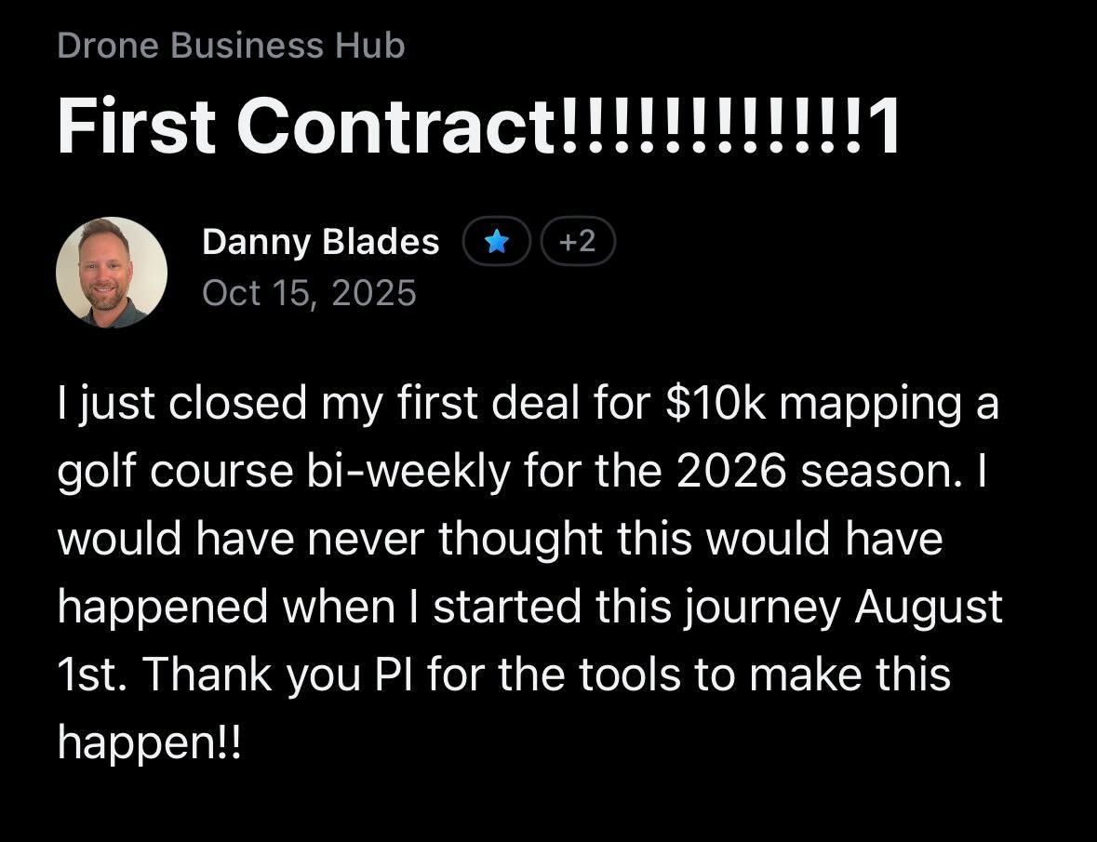
Here's Everything You Get
Drone Business Made Easy Course (7 hrs)
7-Part Strategic Masterclass Series
90-Day Business Launch Cohort
Monthly Live Group Coaching
18+ Skilled Workshops
Business Templates Library
Weekly Industry Insights
Private Networking Community
Course & Merch Discounts

Slide 36
Today, you get ALL of this for
$199
/year

Slide 37
Ready to Stop Waiting? Join the Premium Community Today
48-Hour Special
$159/yr
pilotinstitute.com/community/
Discount expires in 48 hours!
$199 • SAVE 20%
30-Day Money Back Guarantee • Cancel Anytime • Instant Access
Stick around for Q&A to get your FREE PDF action guide!

Slide 38
Feeling Overwhelmed?
You don't have to figure this out alone.
The 90-Day Business Launch Cohort Starts January 19
Weekly structured lessons — know exactly what to do each week
Accountability — stay on track with other pilots
Clear milestones — celebrate progress along the way
Live Q&A sessions — get your specific questions answered
If you wait, the next cohort isn't until May.

Slide 39
Q&A
What questions do you have?
48-Hour Special: $159/year • pilotinstitute.com/community

Slide 40
48-Hour Limited Time Offer
$159
(reg. $199)
48 Hours Only
Your Motivation is at Peak
This 20% discount expires when this webinar replay ends
In 48 hours, you'll be back to your normal routine
90-Day Cohort Starts Jan 19
Remember the Data
Miss it and you miss weeks of structured guidance
The data is clear. Action beats perfection. Start today.
After 48 hours: $199 • Right now: $159 (save 20%)

Slide 41
Your Free Bonus
Part 107 to Paid Action Guide
The complete 3-Part Playbook with all exercises
Complete Client Map worksheets
Pricing framework calculator
Marketing Roadmap templates
Mock job planning checklist
Elevator pitch fill-in-the-blank
7-Day action checklist
Check the chat for your download link!
Now let's do Q&A...

Slide 42
But wait… Because you showed up today...
48-Hour Webinar Special
$159/yr
This offer expires in 48 hours!
$199 • SAVE 20% • $13/mo
<1 real estate shoot
$40 savings
This offer expires in 48 hours!

